Slide 1
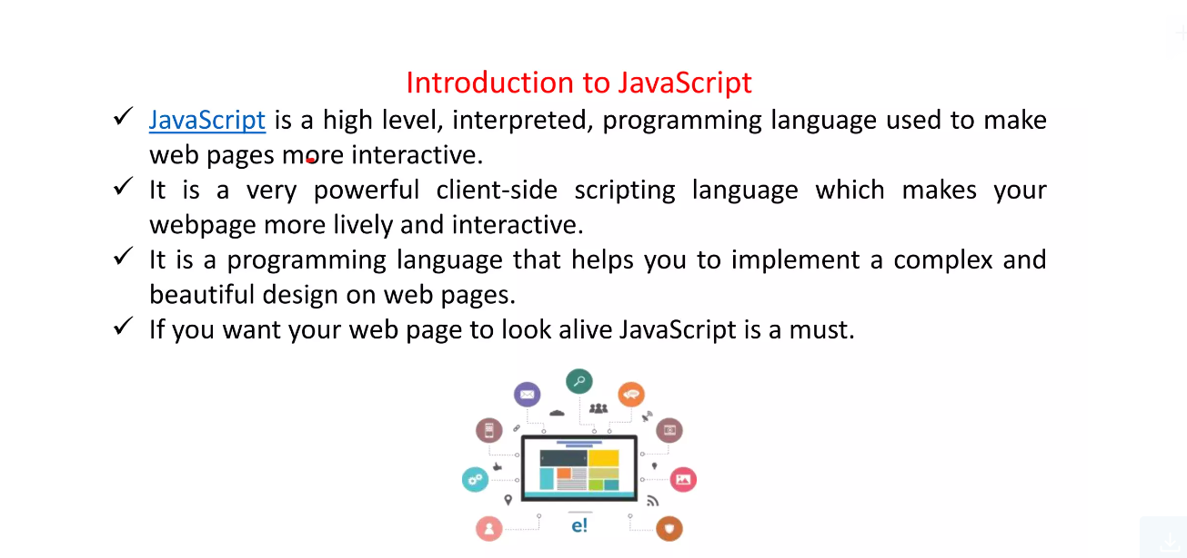

Slide 2
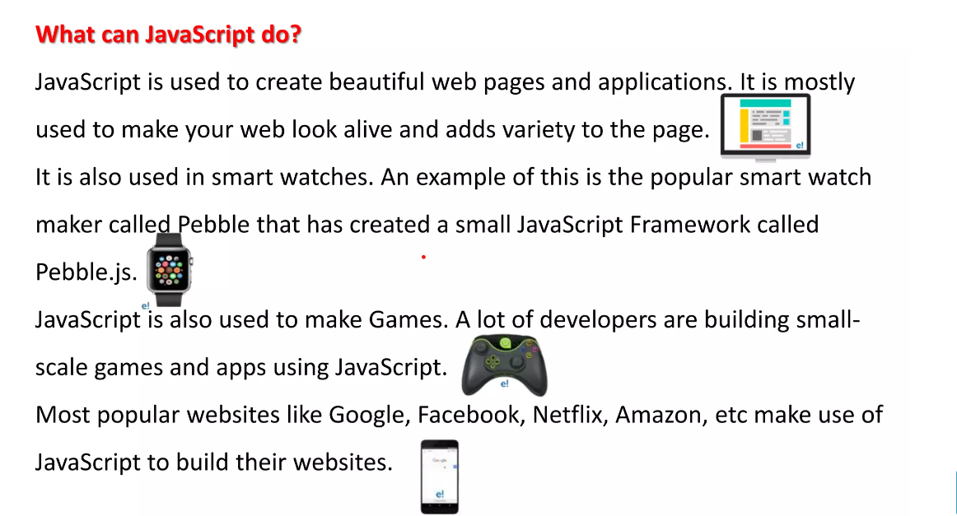

Slide 3
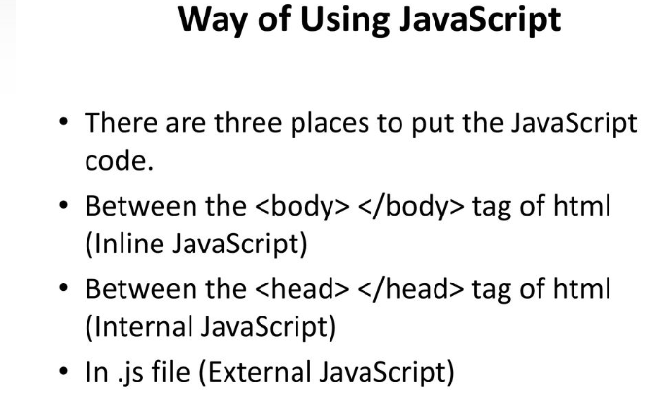

Slide 4
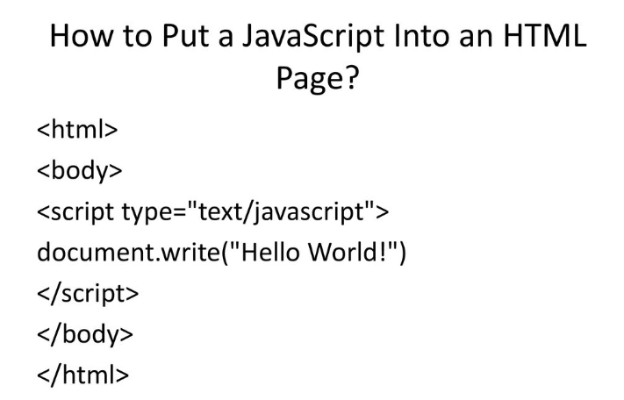

Slide 5
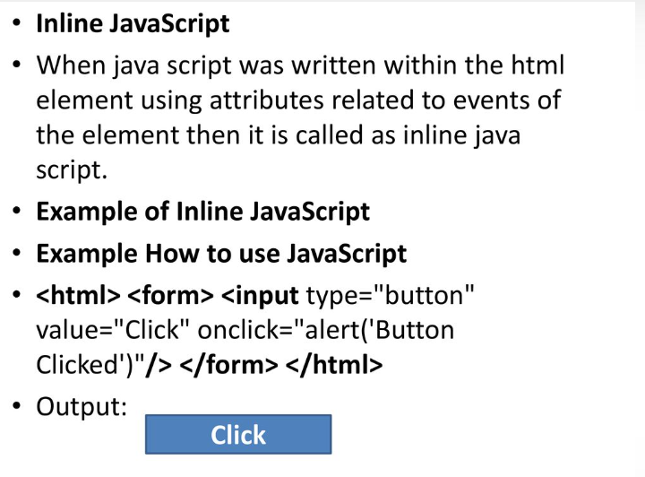

Slide 6
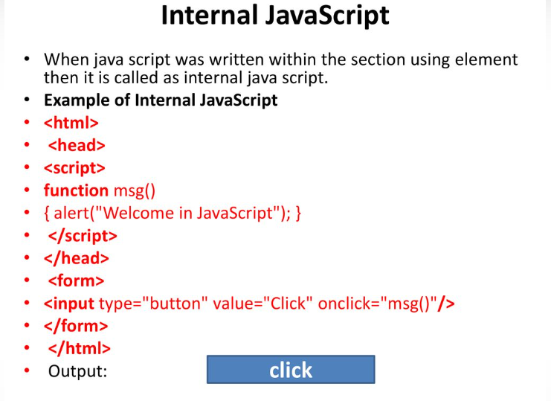

Slide 7
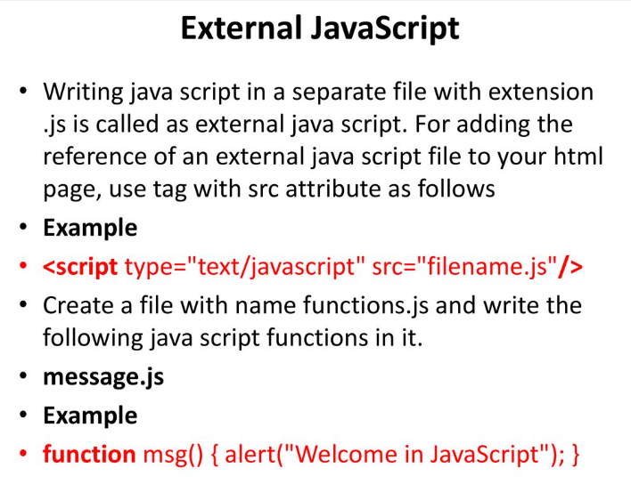

Slide 8
Input Out put in JavaScript
write(); is used to write on browser
document.write(“hello world”)
document.write(a)
prompt(); is used to take input from users
var num = prompt(“Please Enter a Number”)

Slide 9
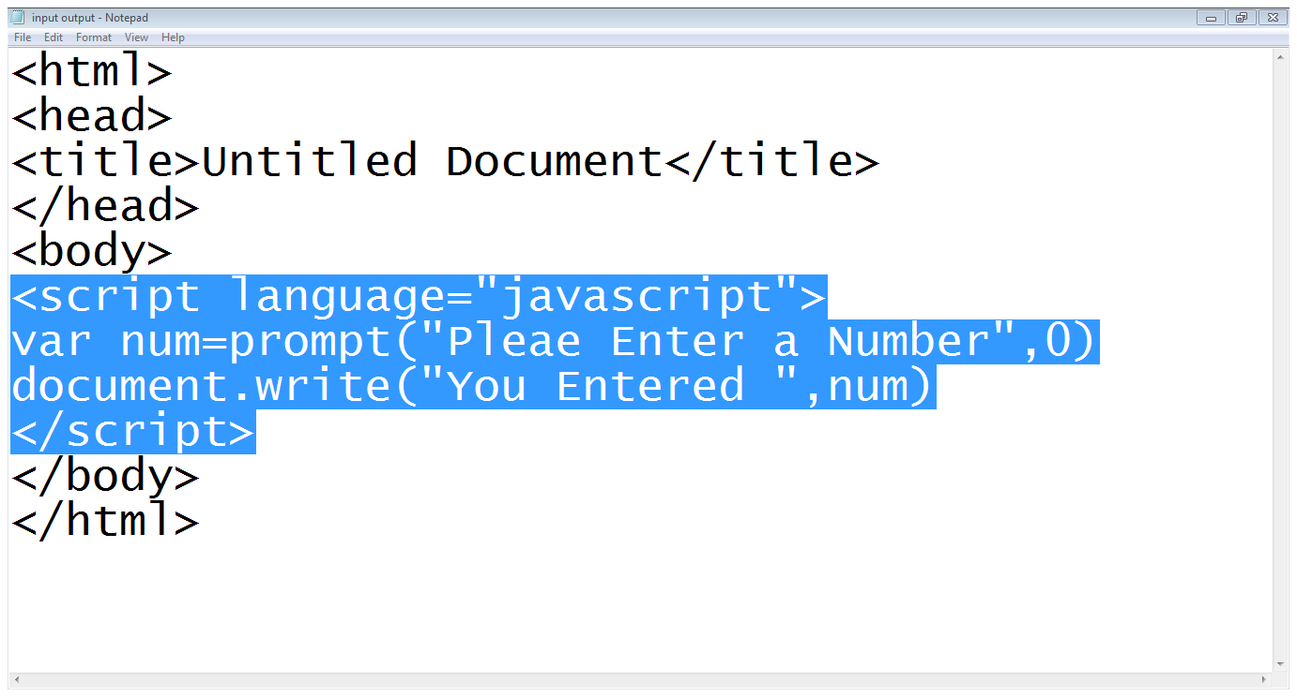
Input Out put in JavaScript…
Start of JS code
User input
Writing on browser
End of Script

Slide 10
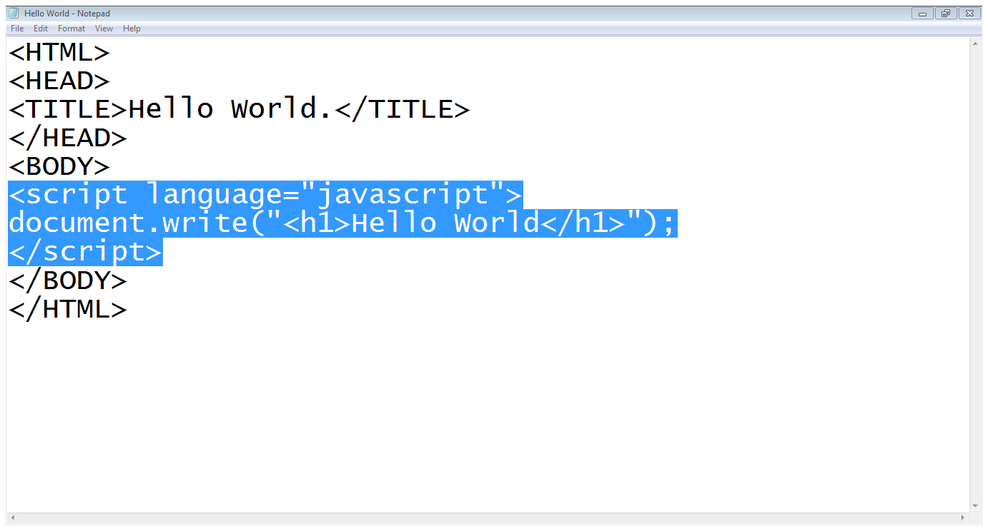
Writing JavaScript
Start of JS script
Writing on webpage
HTML code in JS
End of JS script

Slide 11
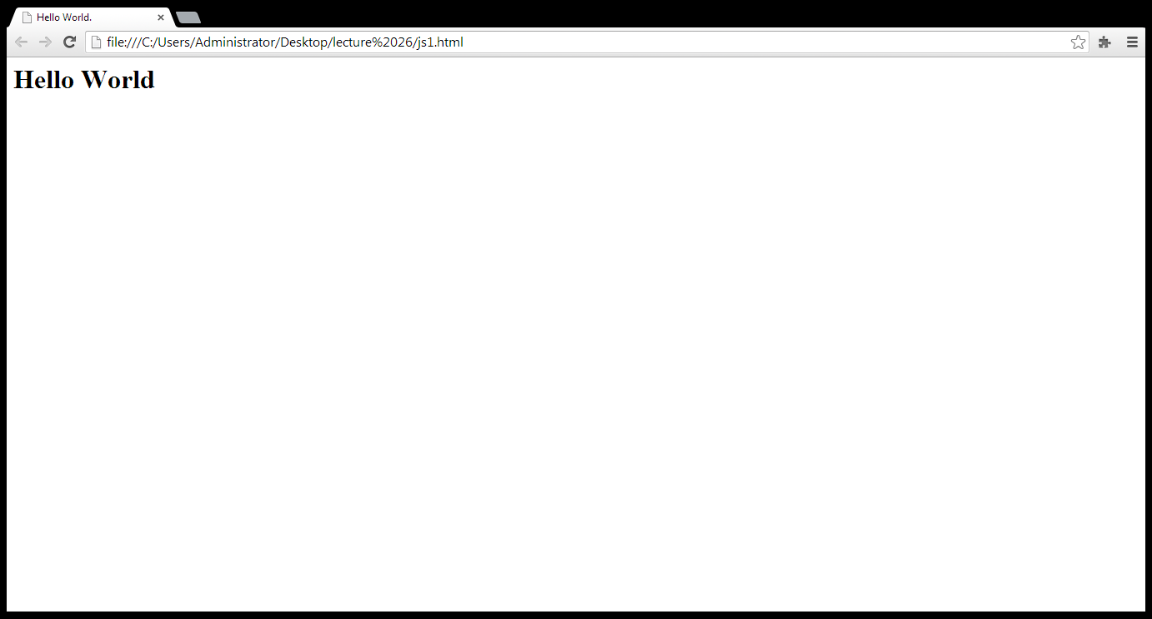
Writing JavaScript…
Out put of the JS code

Slide 12
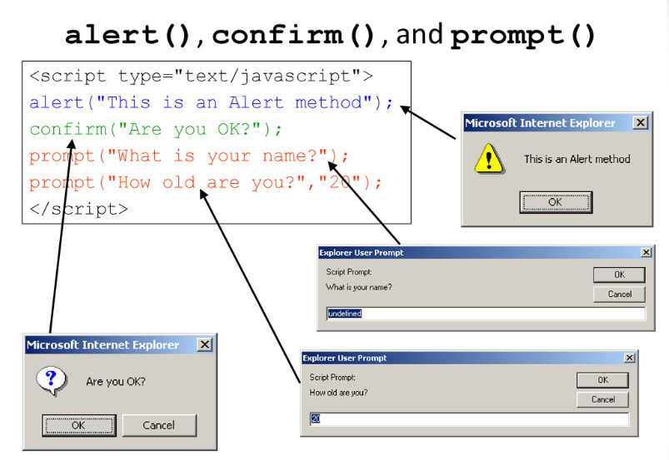

Slide 13
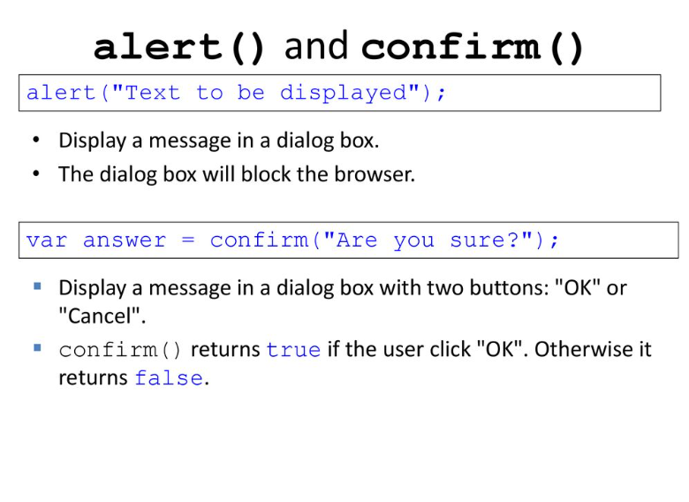

Slide 14

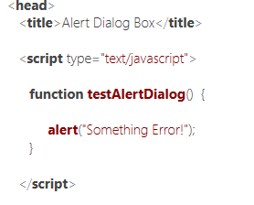
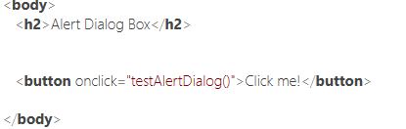
Alert box

Slide 15
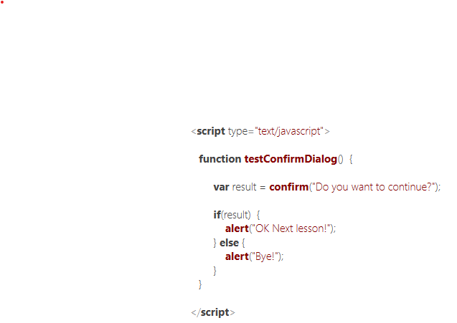
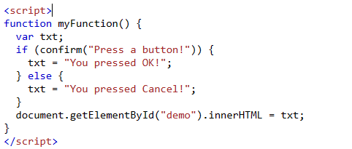
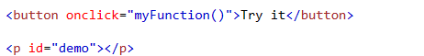
Confirmation message

Slide 16
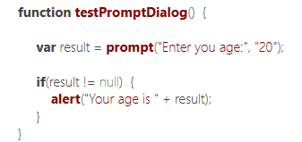


Prompt

Slide 17
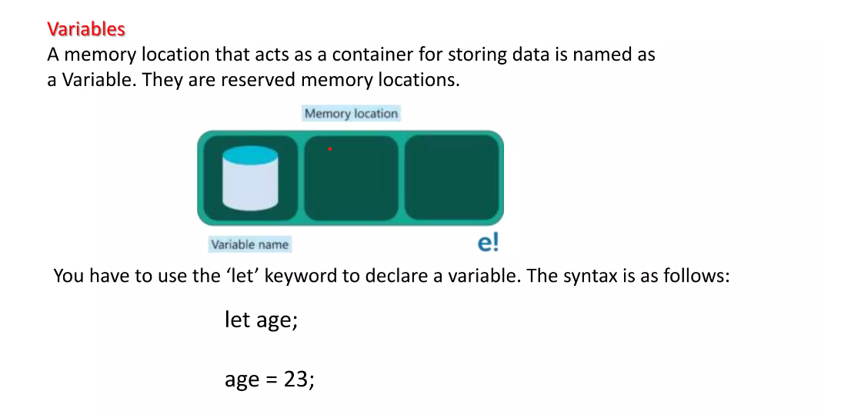

Slide 18
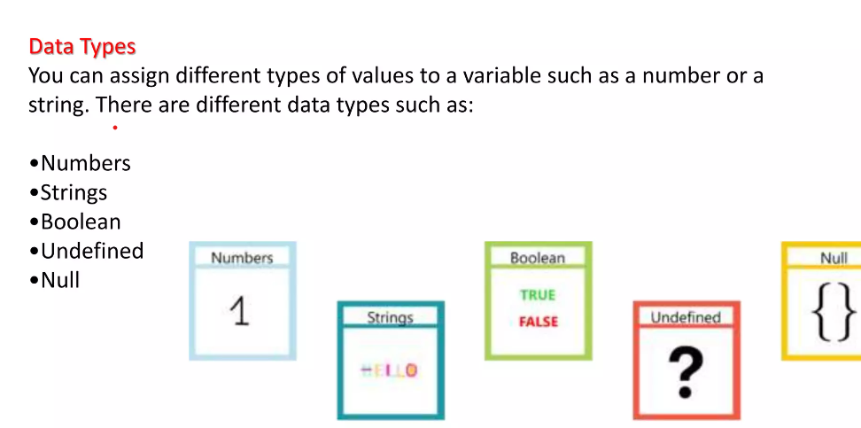

Slide 19
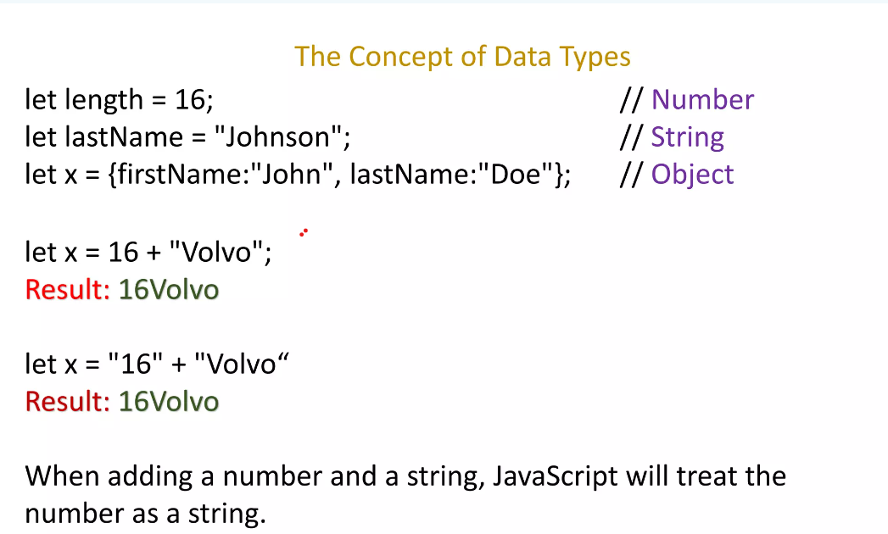

Slide 20
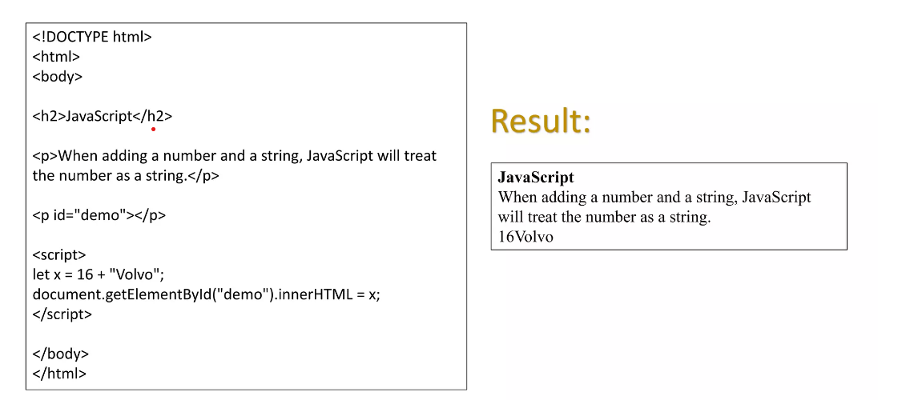

Slide 21
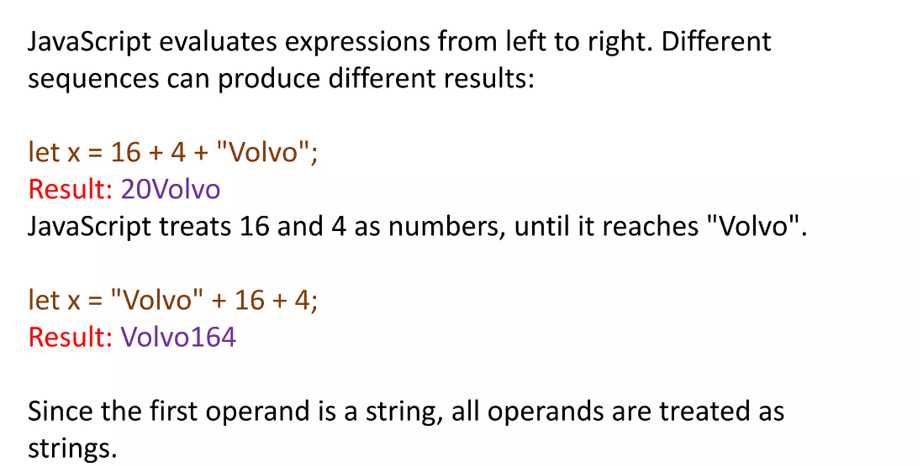

Slide 22
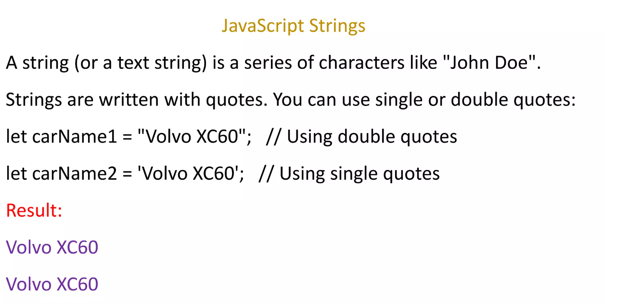

Slide 23
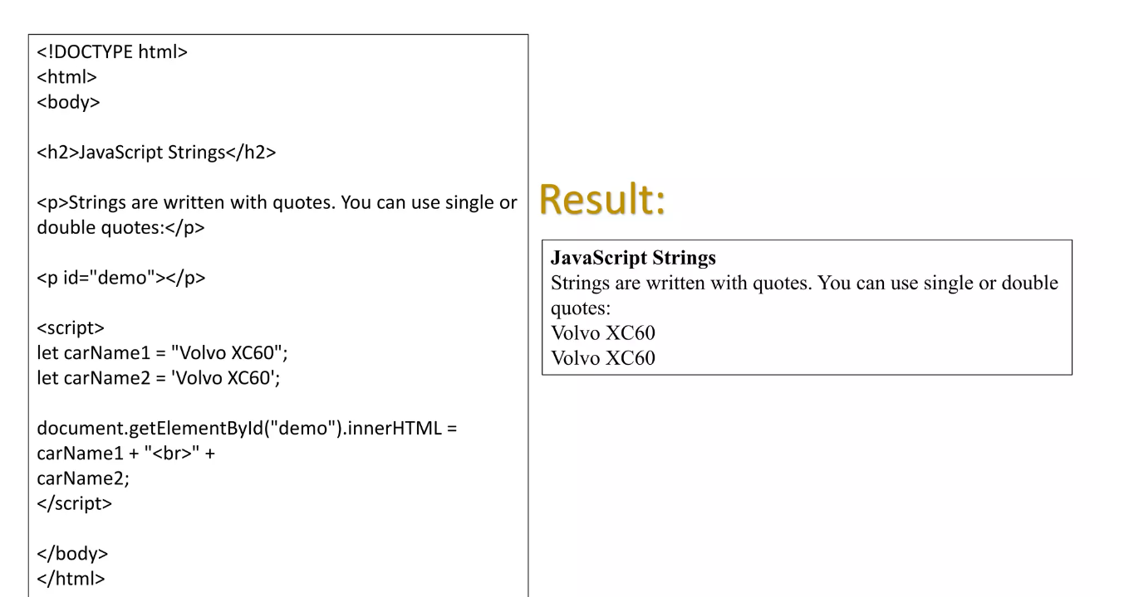

Slide 24
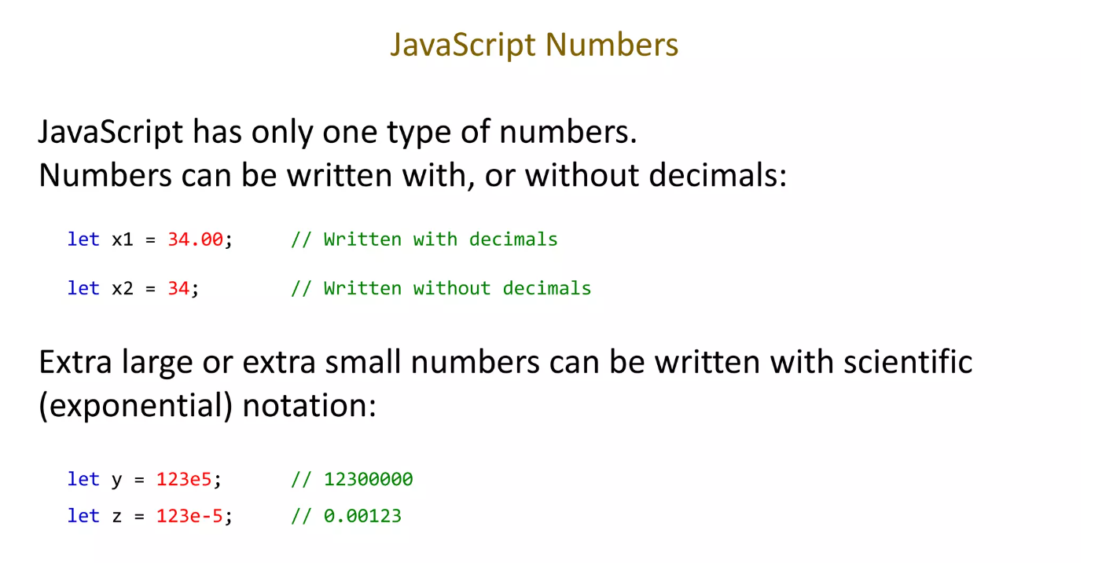

Slide 25
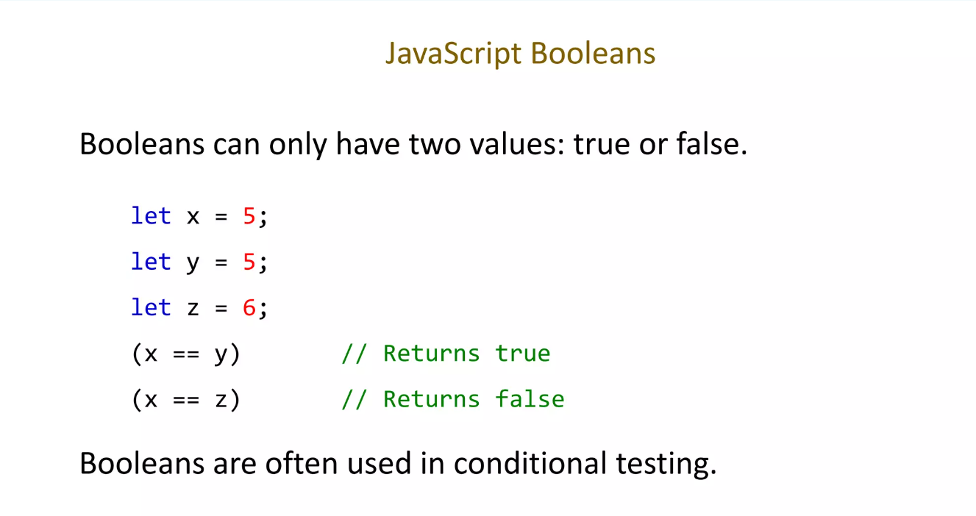

Slide 26
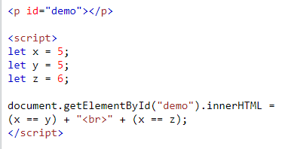
Javascript boolean

Slide 27
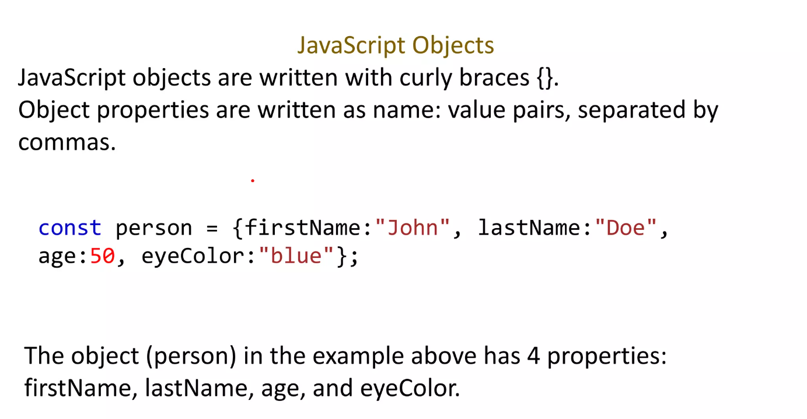

Slide 28
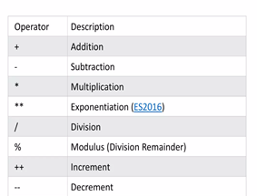
JavaScript operators

Slide 29
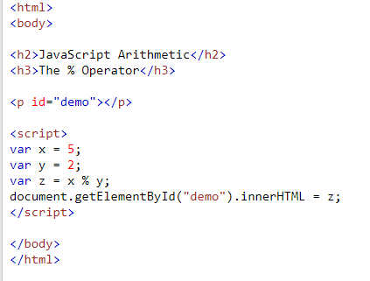
Reminder (modulus)

Slide 30
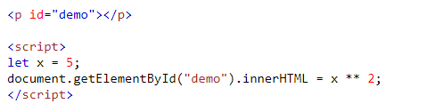
exponentiation

Slide 31
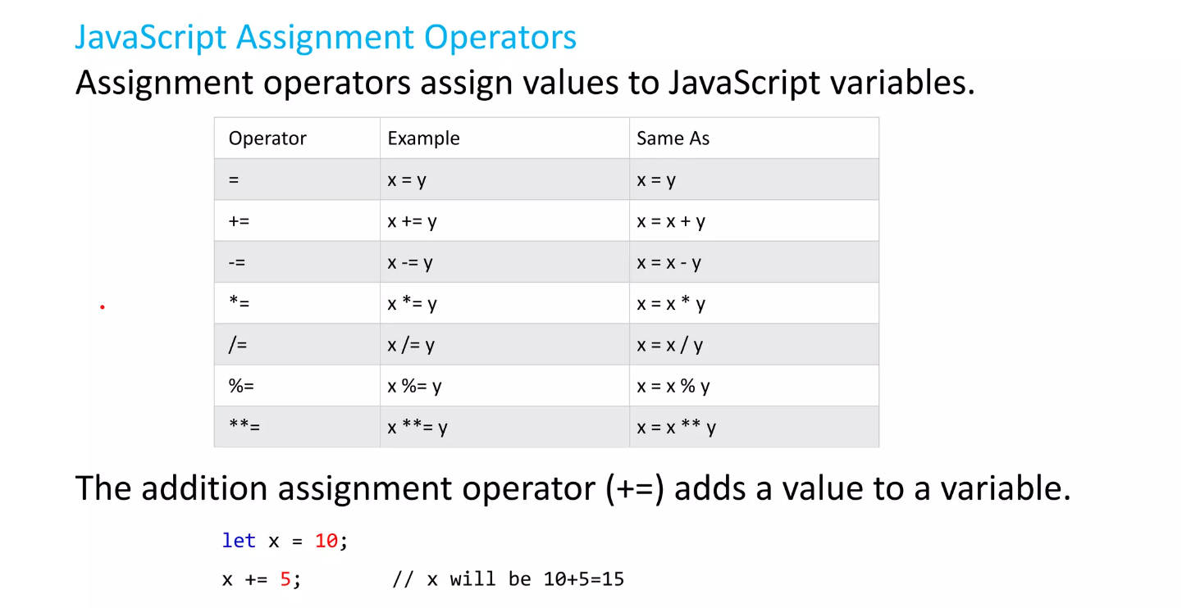

Slide 32
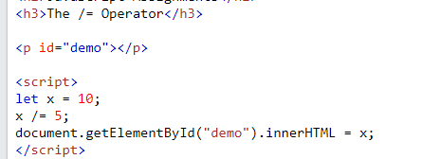
example

Slide 33
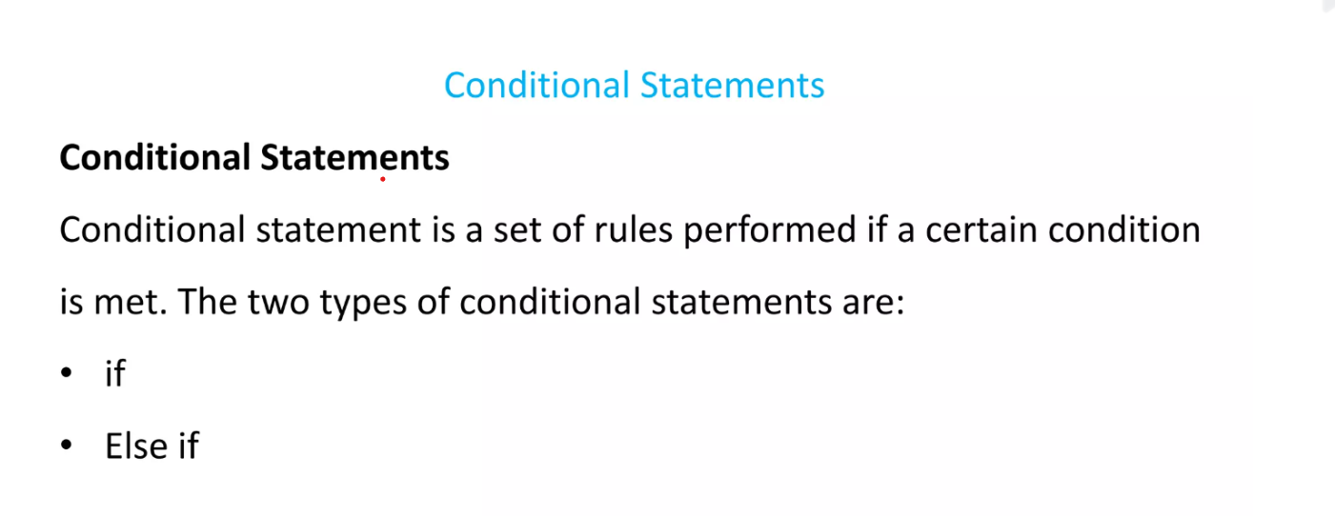

Slide 34
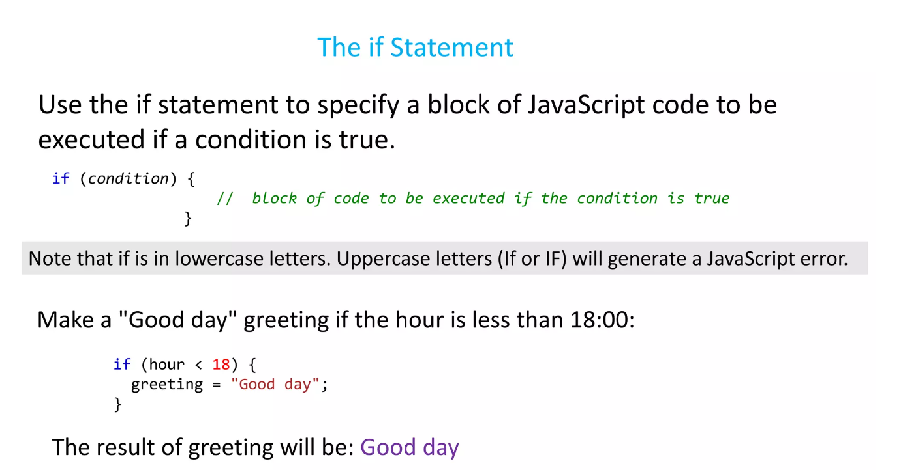

Slide 35
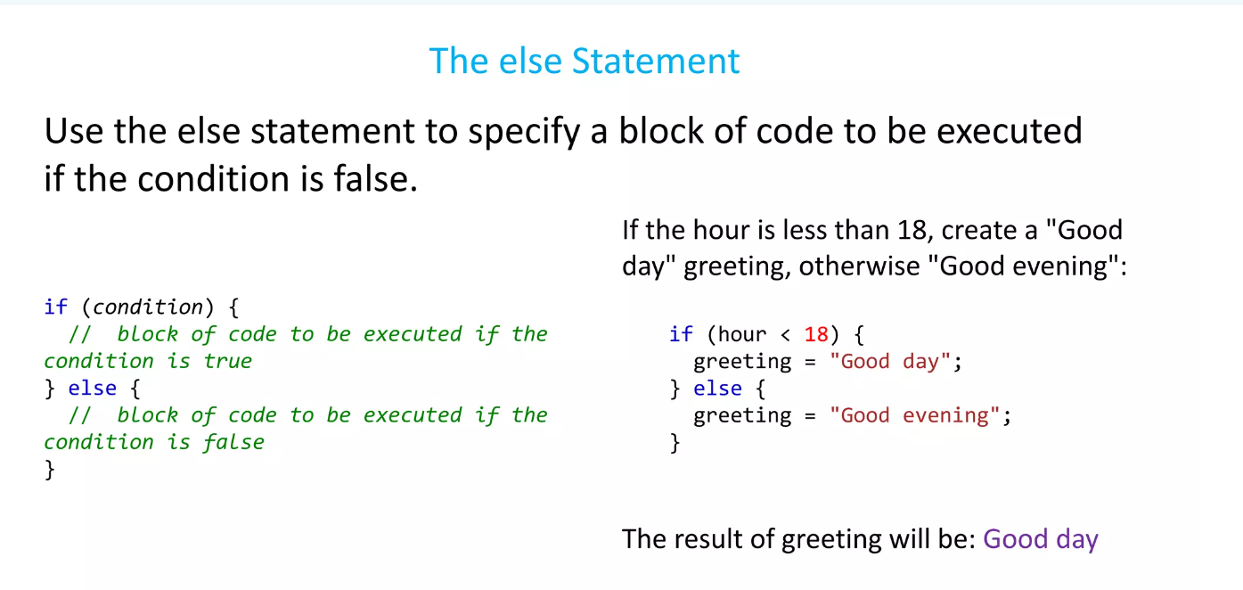

Slide 36
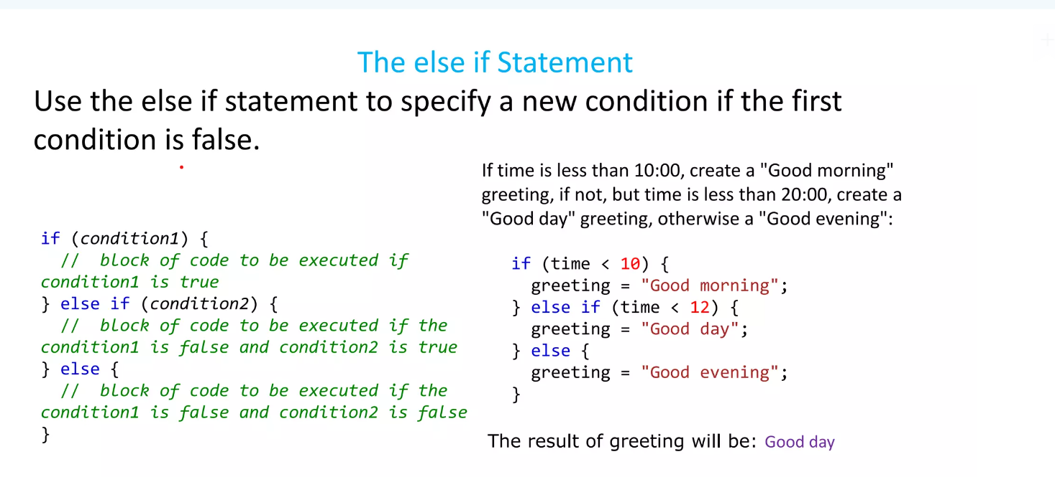

Slide 37
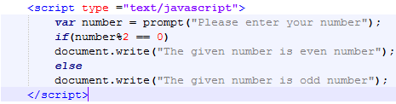
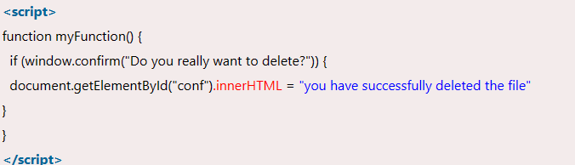
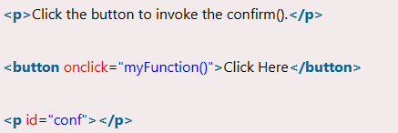
The confirm() function displays a confirmation dialog with "OK" and "Cancel" buttons.If the user clicks OK, it returns true.If the user clicks Cancel, it returns false.

Slide 38
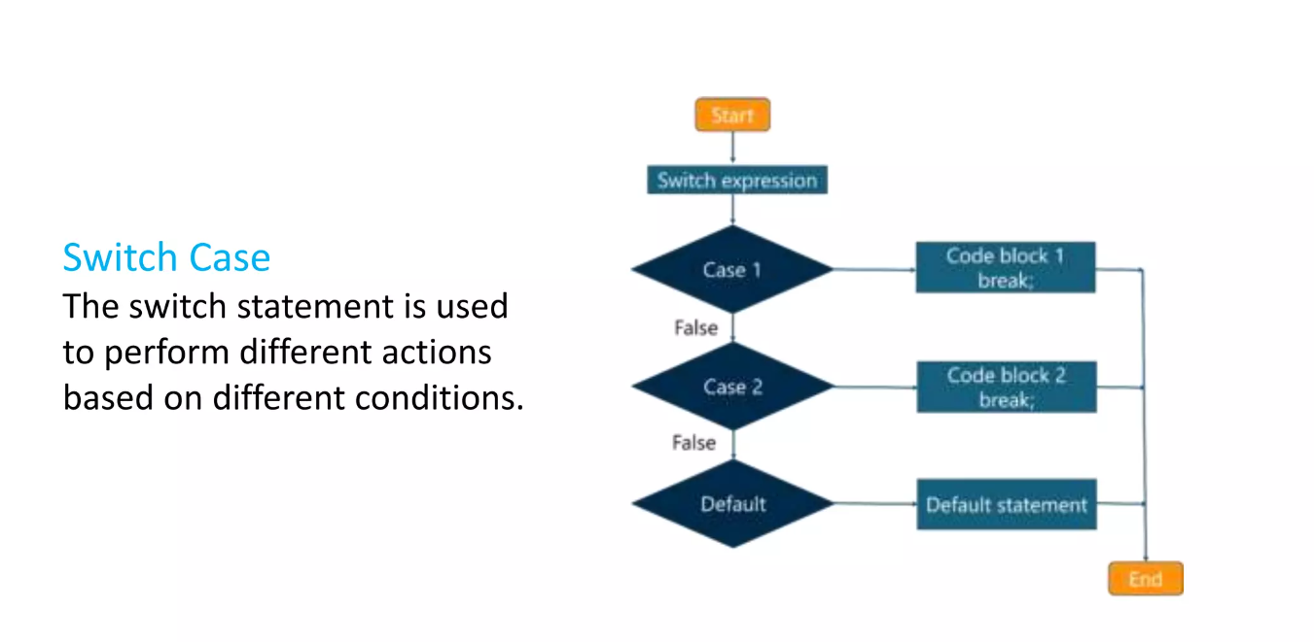

Slide 39
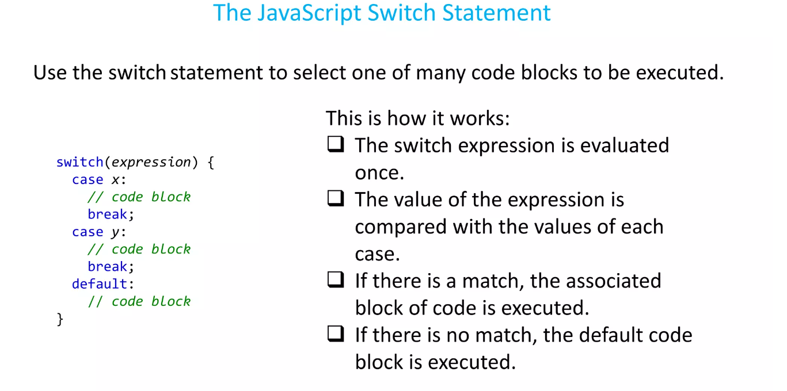

Slide 40
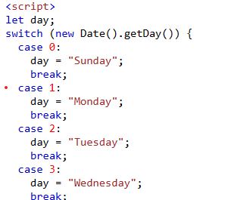
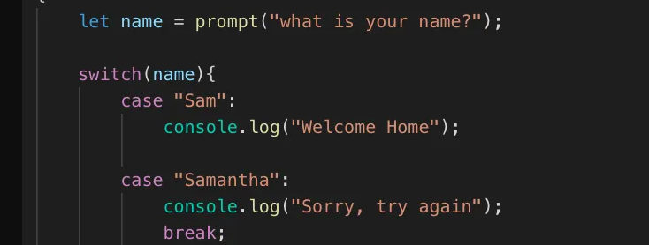


Slide 41
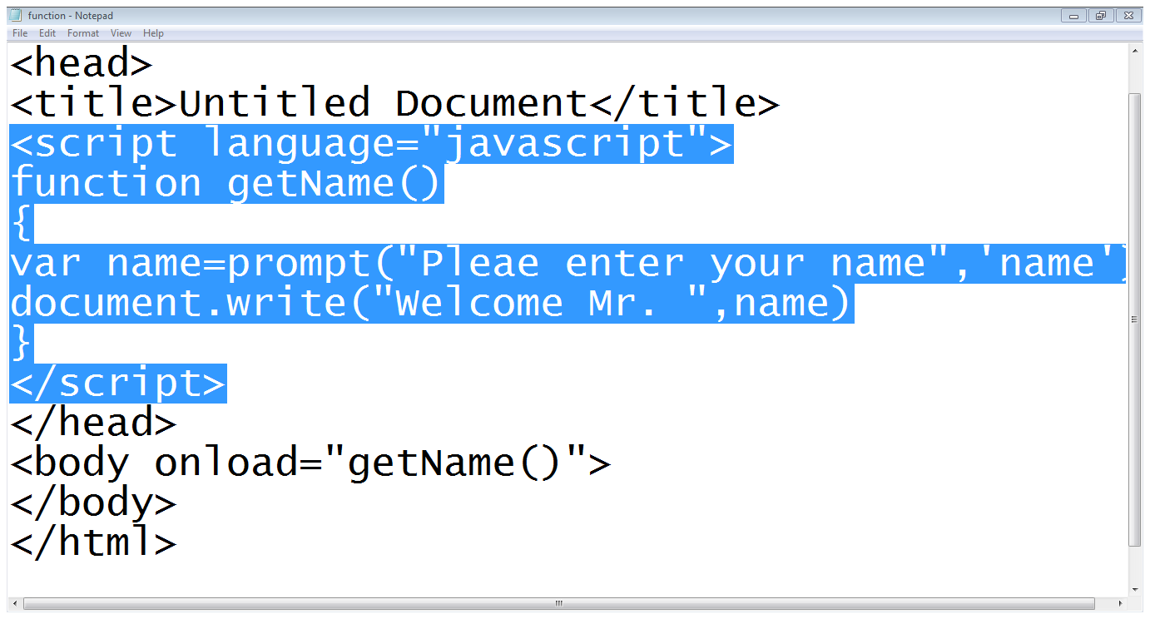
JavaScript Function…
Start of the function
Asks user to enter name
Writes name on the webpage
Calling a function

Slide 42
Events

Slide 43

Event-driven programming
Most JavaScript written in the browser is event-driven:
The code doesn't run right away, but it executes after some event fires.
Example:
Click Me!
Here is a UI element that the user can interact with.

Slide 44
Event-driven programming
Most JavaScript written in the browser is event-driven:
The code doesn't run right away, but it executes after some event fires.
Click Me!
When the user clicks the button...

Slide 45
Event-driven programming
Most JavaScript written in the browser is event-driven:
The code doesn't run right away, but it executes after some event fires.
EVENT!
Click Me!
...the button emits an "event," which is like an announcement that some interesting thing has occurred.

Slide 46

Event-driven programming
Most JavaScript written in the browser is event-driven:
The code doesn't run right away, but it executes after some event fires.
EVENT!
function onClick() {
...
}
Click Me!
Any function listening to that event now executes. This
function is called an "event handler."

Slide 47



A few more HTML elements
Buttons:
Single-line text input:
Multi-line text input:

Slide 48

Using event listeners
Let's print "Clicked" to the Web Console when the user clicks the given button:
We need to add an event listener to the button...
How do we talk to an element in HTML from JavaScript?

Slide 49
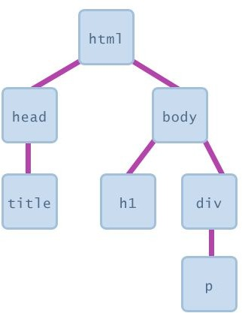
The DOM
Every element on a page is accessible in JavaScript through the DOM: Document Object Model
The DOM is the tree of nodes corresponding to HTML elements on a page.
Can modify, add and remove nodes on the DOM, which will modify, add, or remove the corresponding element on the page.

Slide 50
Getting DOM objects
We can access an HTML element's corresponding DOM object in JavaScript via the querySelector function:
document.querySelector('css selector');
- This returns the first element that matches the given CSS selector
// Returns the element with id="button"
let element = document.querySelector('#button');

Slide 51
Adding event listeners
Each DOM object has the following function:
addEventListener(event name, function name);
- event name is the string name of the JavaScript event you want to listen to
- Common ones: click, focus, blur, etc
- function name is the name of the JavaScript function you want to execute when the event fires

Slide 52
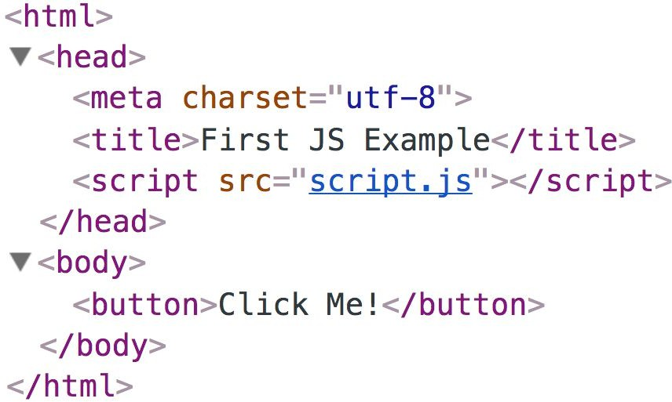
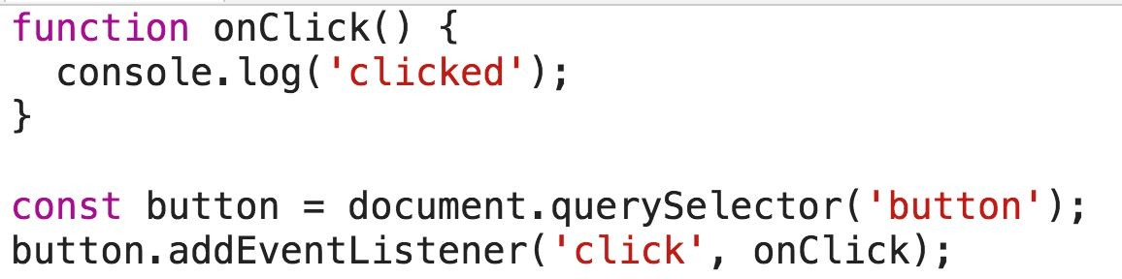

Slide 53
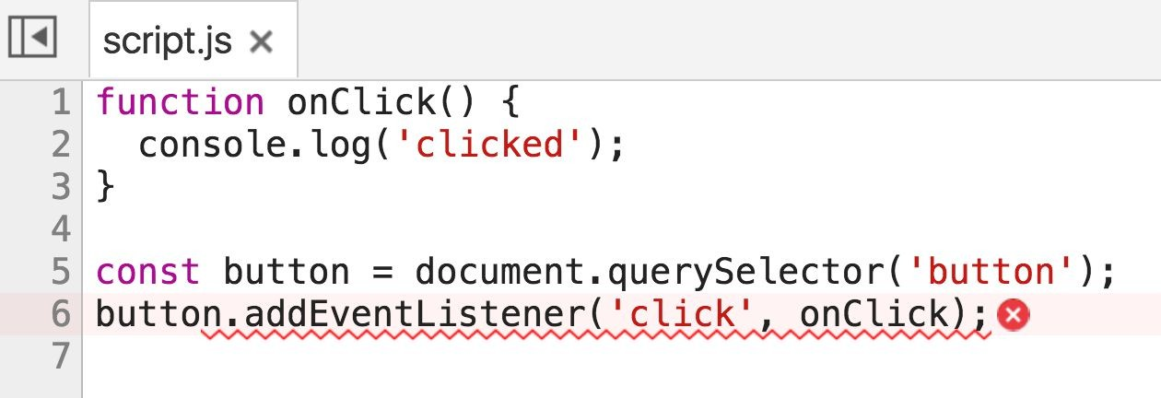

Error! Why?

Slide 54






<head>
<title>CGS 3066</title>
<link rel="stylesheet" href="style.css" />
<script src="script.js"></script>
</head>

Slide 55


<head>
<title>CSGS 3066</title>
<link rel="stylesheet" href="style.css" />
<script src="script.js"></script>
</head>

Slide 56



<head>
<title>CSGS 3066</title>
<link rel="stylesheet" href="style.css" />
<script src="script.js"></script>
</head>

Slide 57
<head>
<title>CS 193X</title>
<link rel="stylesheet" href="style.css" />
<script src="script.js"></script>
</head>
function onClick() { console.log('clicked');
}
const button = document.querySelector('button'); button.addEventListener('click', onClick);

Slide 58
<head>
<title>CS 193X</title>
<link rel="stylesheet" href="style.css" />
<script src="script.js"></script>
</head>
function onClick() { console.log('clicked');
}
const button = document.querySelector('button'); button.addEventListener('click', onClick);
We are only at the <script> tag, which is at the top of the document… so the <button> isn't available yet.

Slide 59
<head>
<title>CS 193X</title>
<link rel="stylesheet" href="style.css" />
<script src="script.js"></script>
</head>
function onClick() { console.log('clicked');
}
const button = document.querySelector('button'); button.addEventListener('click', onClick);
Therefore querySelector returns null, and we can't call addEventListener on null.

Slide 60
Use defer
You can add the defer attribute onto the script tag so that the JavaScript doesn't execute until after the DOM is loaded (mdn):
<script src="script.js" defer></script>

Slide 61
Use defer
You can add the defer attribute onto the script tag so that the JavaScript doesn't execute until after the DOM is loaded (mdn):
<script src="script.js" defer></script>
Other old-school ways of doing this (don't do these):
Put the <script> tag at the bottom of the page
Listen for the "load" event on the window object
You will see tons of examples on the internet that do this. They are out of date. defer is widely supported and better.

Slide 62



